Slide 1

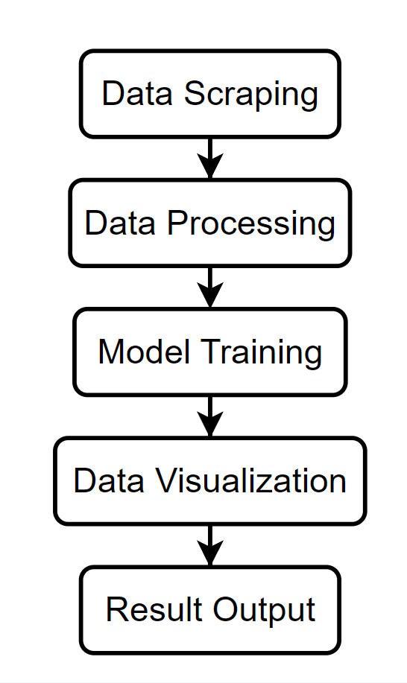

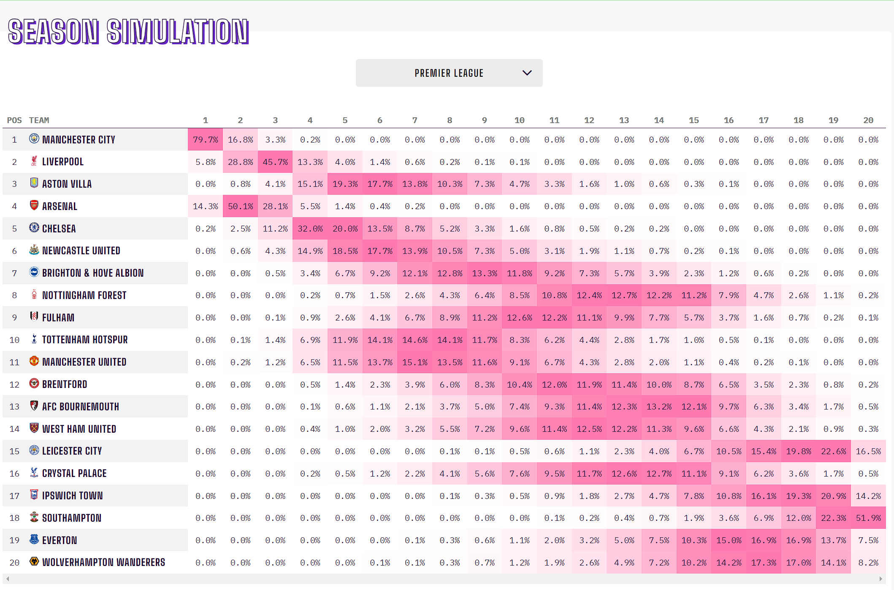
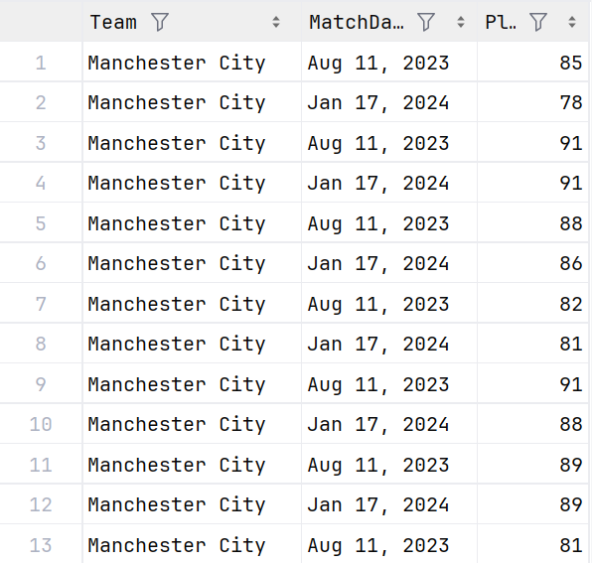
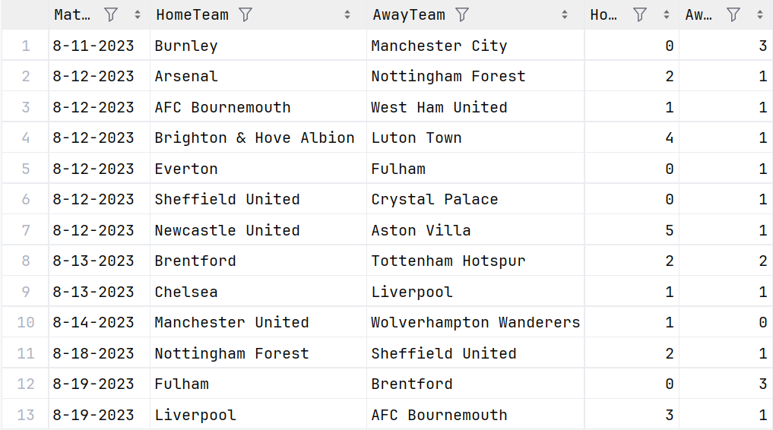
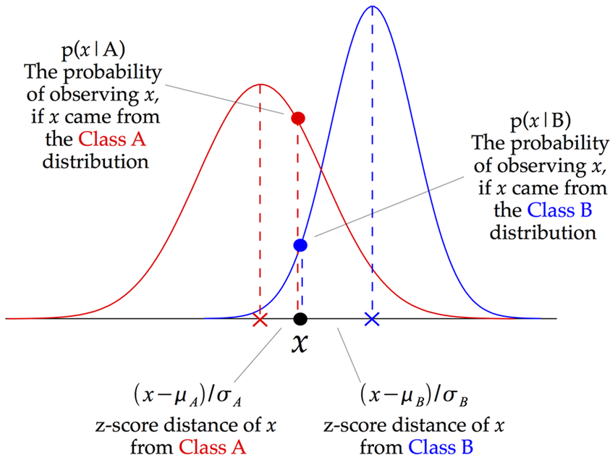
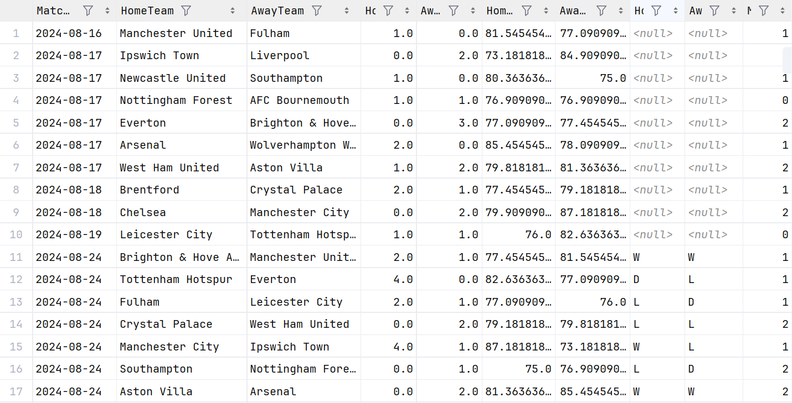
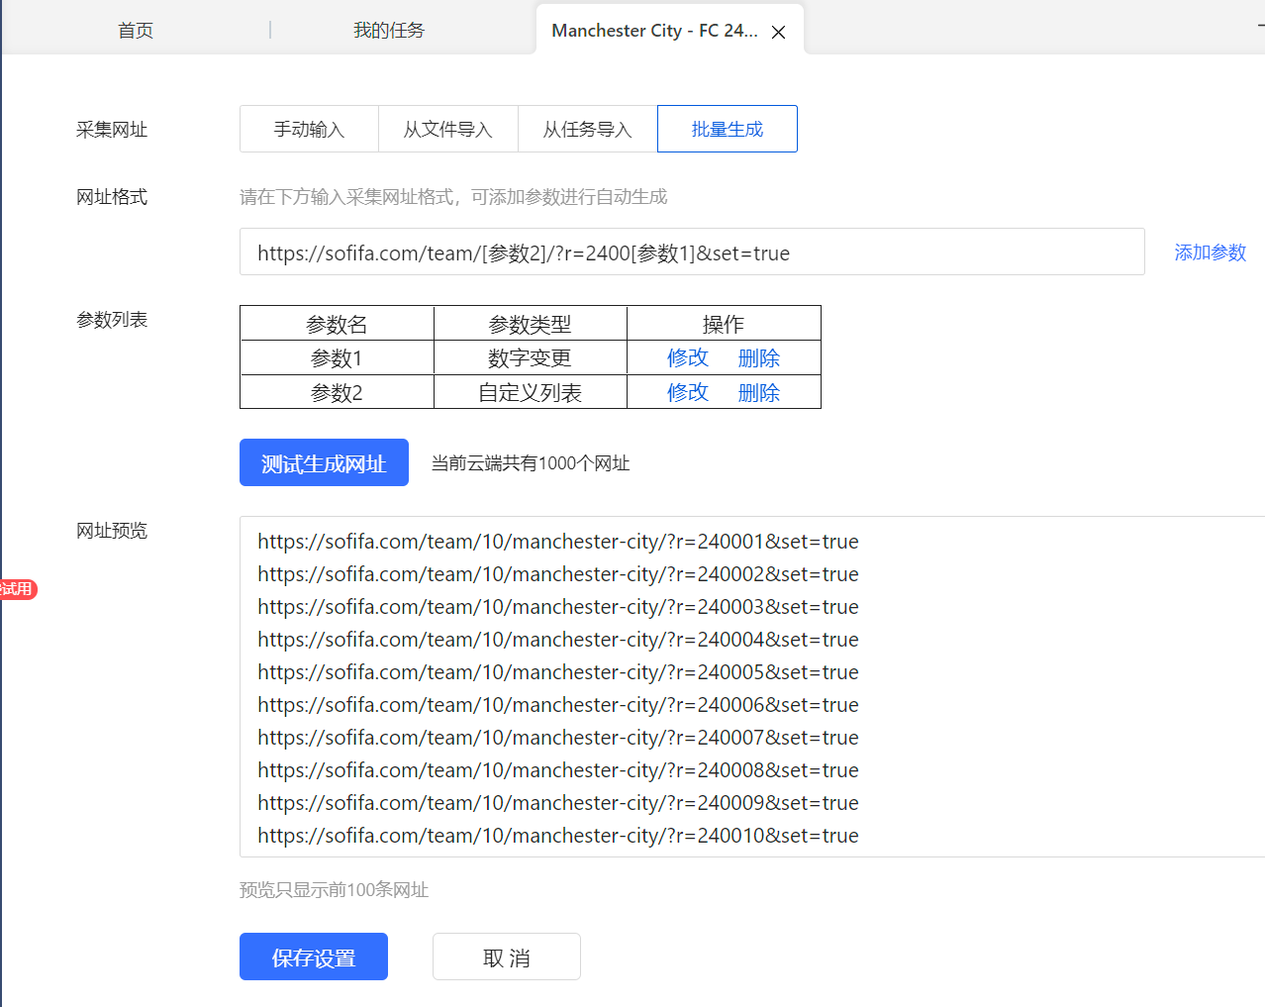
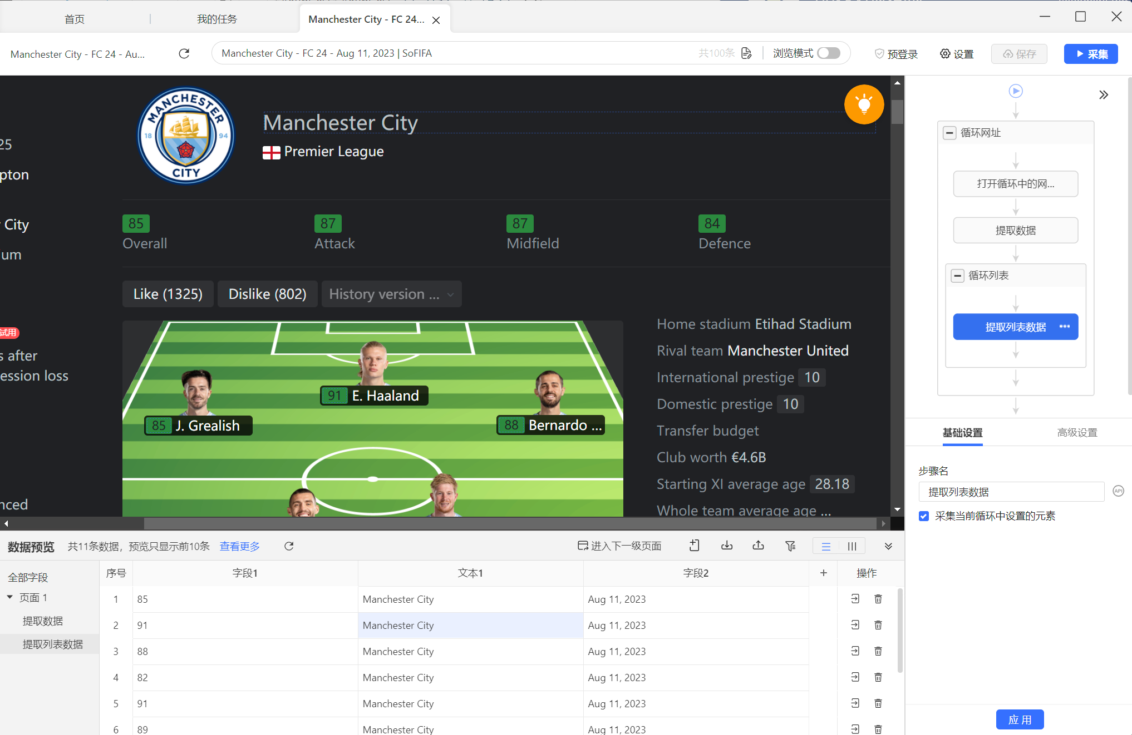
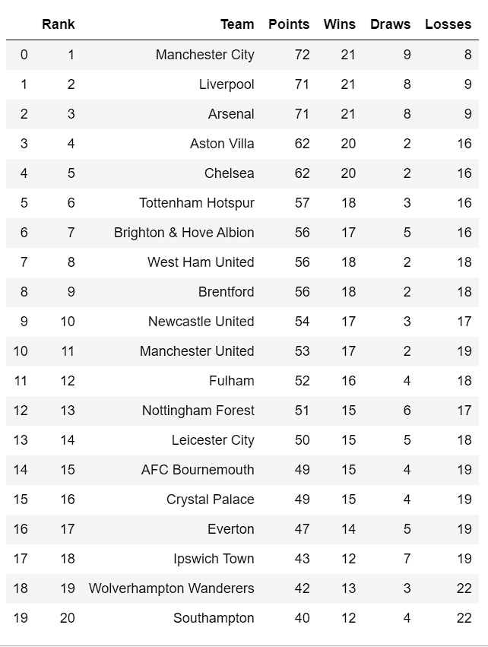
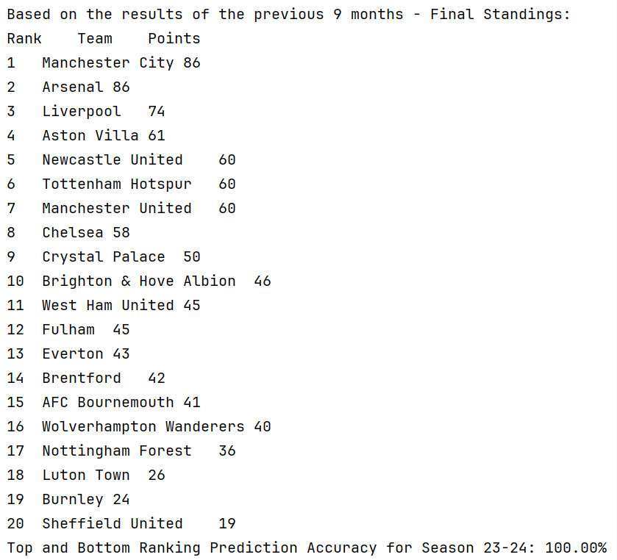
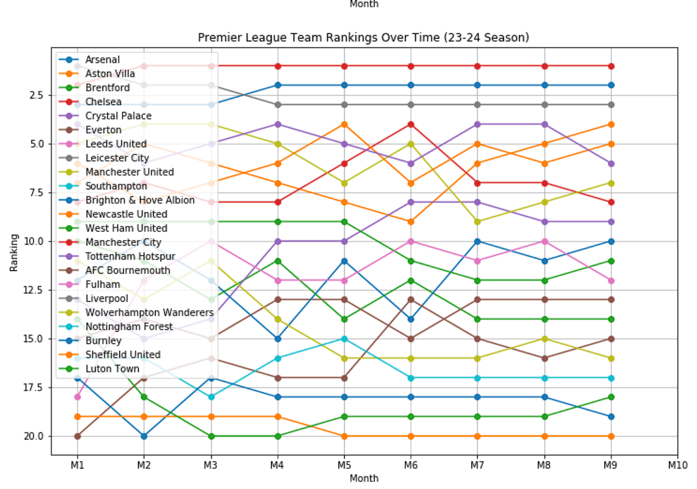

24-25 Premier League Prediction
$$Zhonghan Dai;Yuxi Zheng;Jianming Fu$$
Duke Kunshan University, Kunshan, China
Introduction
The English Premier League (EPL) is renowned for its competitive spirit and global fanbase. Accurate match prediction in football has significant implications for analytics and betting industries. Inspired by the intersection of this challenge with machine learning concepts learned in class, we initiated this project to predict EPL match outcomes.
Project Flow Chart
Proposed Model
Experimental Setup
Functionality Implementation
Data Processing & Matching
Regarding the design of the model, we learned the basic logic of prediction for the leaderboard from Opta Football Predictions: by generating predictions, comparing the ability values of all teams, referencing the historical performance of the teams, predicting all matches in the schedule, and thereby calculating the final leaderboard.
We process the raw data to generate team ratings for each game, then match these ratings with the schedule and results to produce the final dataset.
EPL 24-25 Season Prediction from Opta
Model Selection: Gaussian Naive Bayes Algorithm
Simplicity, multidimensional capability, and speed. Crucially, what makes Gaussian Naive Bayes a good fit is its effectiveness when dealing with normally distributed numerical data, such as ratings or counts. Football match data often involves numerical ratings or tallying certain types of occurrences, which align well with the assumptions of the Gaussian Naive Bayes model. Initially, there was uncertainty regarding the suitability of the model, but, fortunately, it has proven to be effective.
Raw Data from Bazhuayu
EPL Match Results from Internet
Gaussian Naive Bayes Algorithm
Data Scraping
Final Data after Processing & Matching
We set two parameters to generate URLs for the lineups and player ratings of all teams in a single Premier League season's 380 matches on Sofifa.com. Then use the Bazhuayu software to scrape the data.
Evaluation metrics
We searched for scoreboards from previous seasons and compared them to our predticed scoreboard. We also found out that teams ranking in the middle of the league(6 to 15) is always fluctuating, which make it hard to predict accurately. However, the accuracy of teams in the top 5 and last 5 is always relatively high, at about 80%.
Batch Generation of URLs
Bazhuayu Software UI
Results and Conclusions
Results
Conclusions
According to our code, Mancheter City will win the trophy this season and Ipswich Town, Wolvehampton Wanderes and Southampton will relegate. But we have not taken the transfer maket this winter into our consideration since it will begin at January 2025. So there will be some difference with the real result when the season end at 2025 June.
This model is about football game match prediction, but it can
be modified and used in other areas where need prediction
and estimation.Our job is similar to some departments in sports analysis company like ESPN and SkySports. Given that this is a small-sized project, there are some improvements we can make. For example, teams’ total yellow card and red card number, stadium condition and weather can be also considered in the model to achieve higher accuracy.
Scoreboards Prediction & Accuracy in Previous Seasons
Previous Seasons Scoreboards Line Chart
Scoreboard Prediction of EPL 24-25

